Slide 1
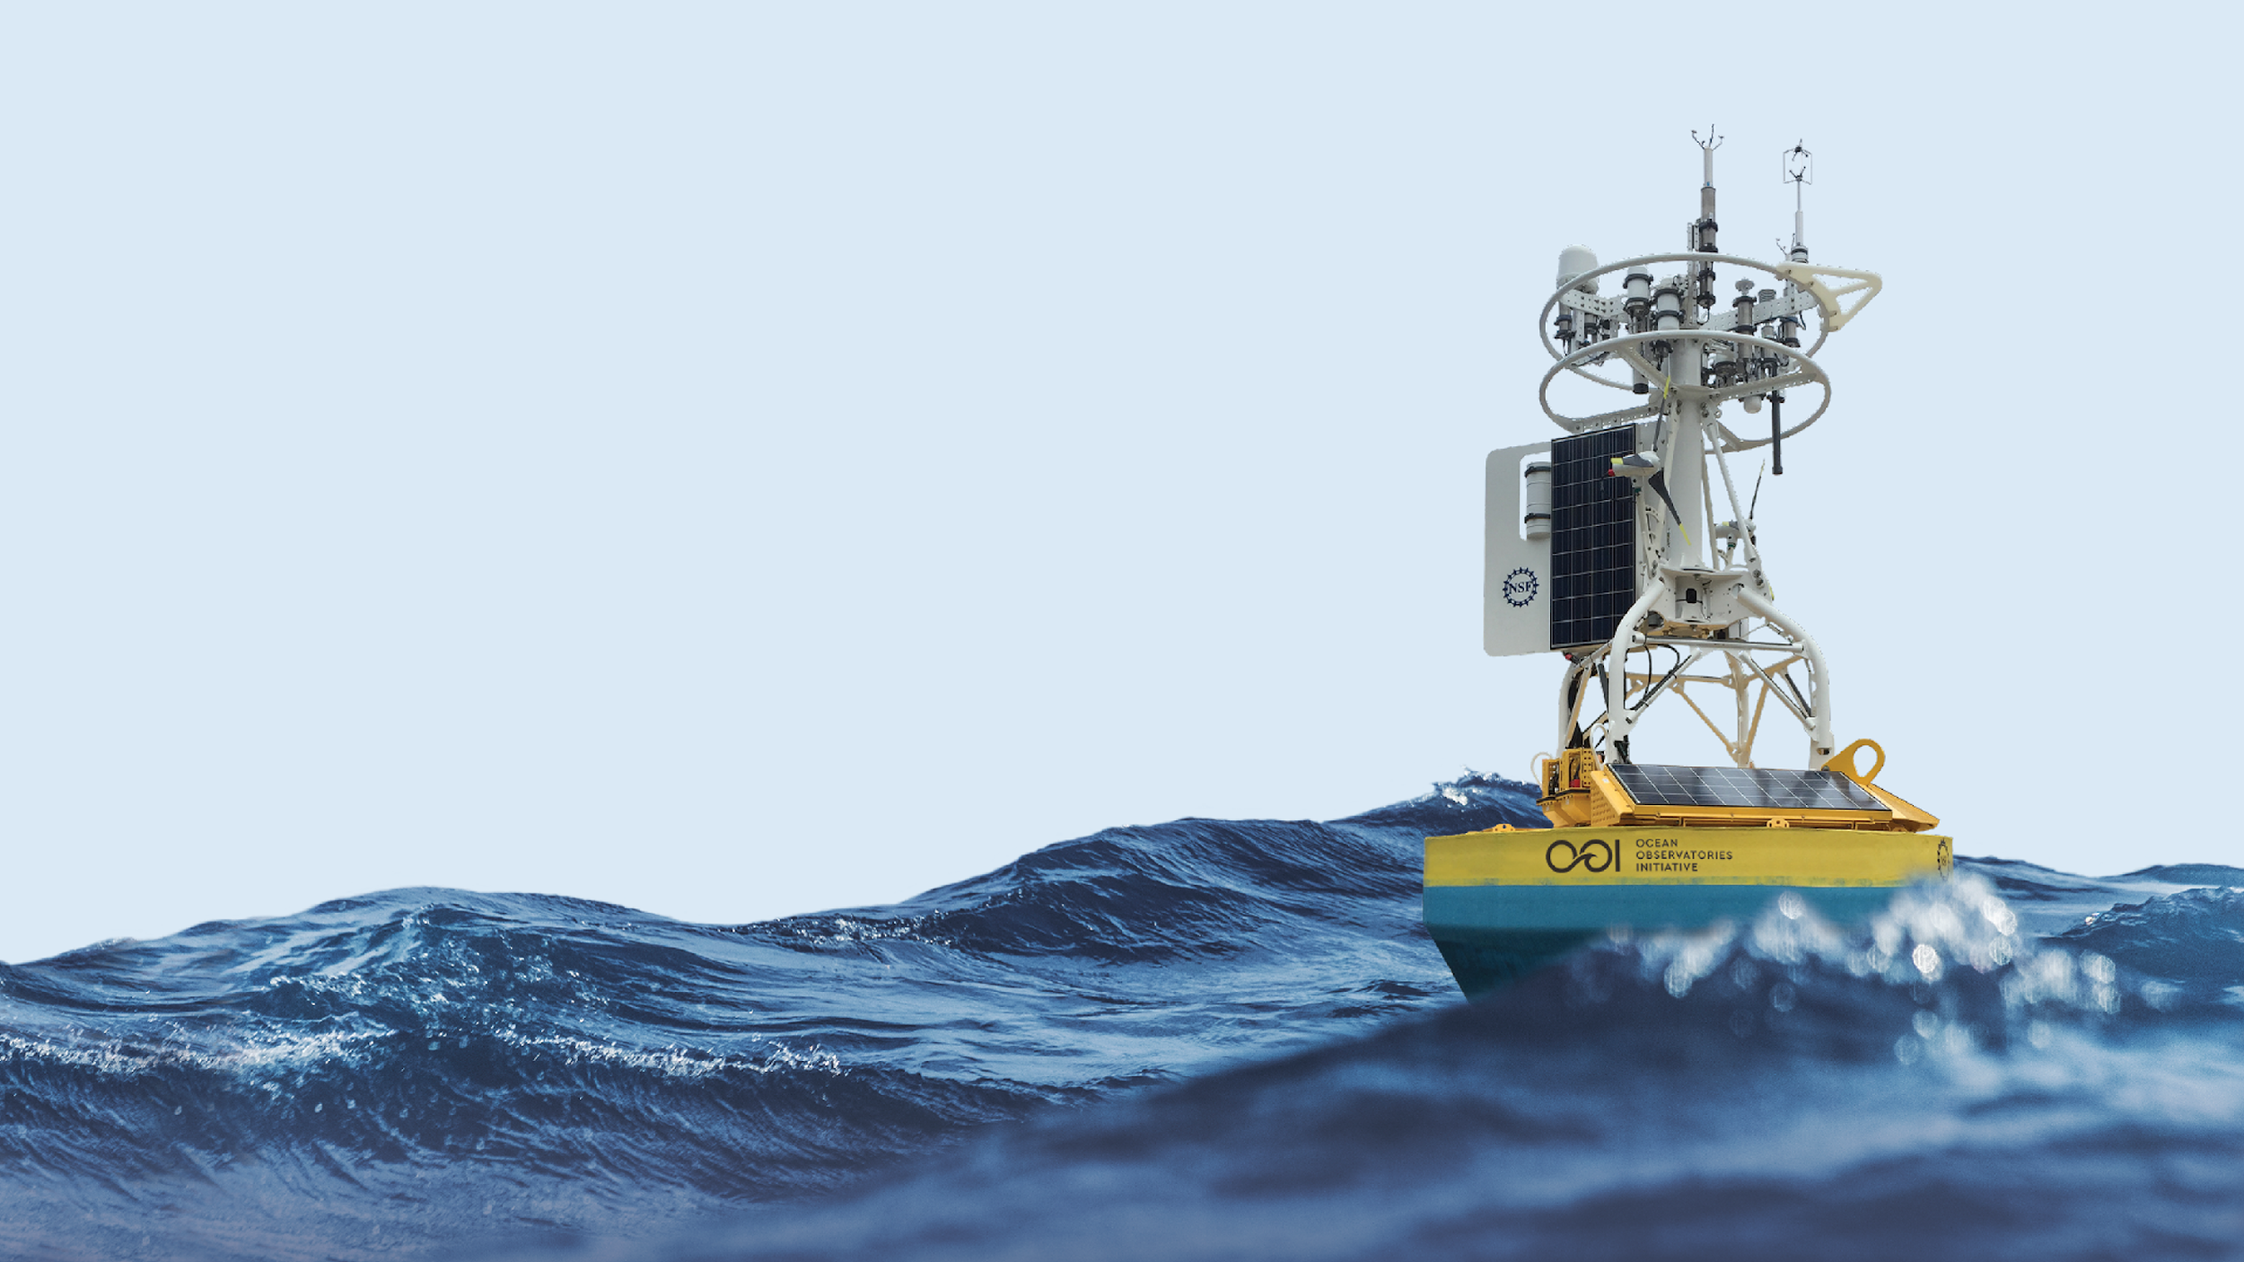



OOI Carbon System:
Data Validation
with discrete bottle data
OOI Booth - March 2nd, 2022 Andrew Reed

Slide 2
Discrete Water Sampling
OOI collects discrete water samples during CTD casts at each mooring recovery and deployment at each instrument depth. Analysis is performed by outside labs. Analysis include:
Oxygen
Salinity
Nutrients (Nitrate, Nitrite, Ammonium, Phosphate, Silicate)
Chlorophyll
Carbon System
Data are publicly available at OOI Alfresco Web Document Server (alfresco.oceanobservatories.org)
OOI > Array > Cruise Data > Cruise > Ship Data > Water Sampling
Currently creating master summary spreadsheets which merged all datasets into a single file.
Cruises with CTD and Bottle Data:
Coastal Pioneer - 17 cruises spaced ~6 months apart dating to 2014
Coastal Endurance - 15 cruises spaced ~6 months apart dating to 2013
Irminger - 8 cruises spaced ~12 months apart dating to 2014
Ocean Station Papa - 8 cruises spaced ~12 months apart dating to 2013
Argentine Basin - 4 cruises spaced ~12 months apart from 2015-2018
Southern Ocean - 6 cruises spaced ~12 months apart from 2015-2020
Cabled Array - 12 cruises spaced ~12 months apart dating to 2013
Notes:
For CGSN

Slide 3
What carbon system parameters are measured?
Array | Total Alkalinity | DIC | pH | pCO2
Cabled Array^{C} | -- | X | -- | X
Coastal Endurance^{C} | -- | X | -- | X
Coastal Pioneer^{A} | X | X | X | --
Global Irminger^{A} | X | X | X | --
Global Papa* | (1, 2, 3, 6, 7, 8)^{A,B} | X^{A,B,C} | (6, 7, 8)^{A} | (4, 5)^{C}
Global Argentine Basin^{A} | X | X | X | --
Global Southern Ocean^{A} | X | X | X | --
Samples processed by the Wang CO2 Lab, Woods Hole Oceanographic Institute
Samples processed by the Dickson Lab, Scripps Institute of Oceanography
Samples processed by Hales Carbon System Lab, Oregon State University
*) Samples have been processed by different labs at different times

Slide 4
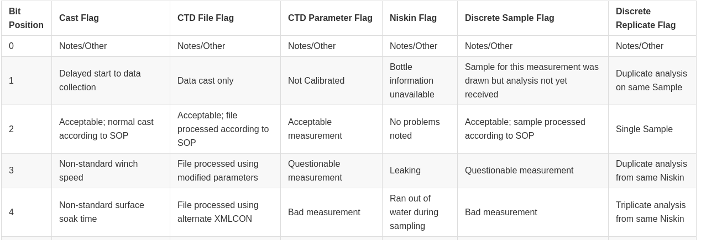
Quality Flags
Quality Flags are provided for each CTD parameter and Discrete Water parameter measured
Flags are encoded as a 16-bit array, read from left to right
Definitions for each bit in an array for a particular parameter can be found in a definition table included in the cruise water sampling README.txt file
E.g. a flag of *0000000000000010 for the CTD File Flag indicates a data cast only
E.g. a flag of *0000000000001001 for the Niskin Flag indicates that the bottle was leaking and to check for notes about that sample
Flags also indicate whether a sample is a replicate

Slide 5
Interpreting Quality Flags
Niskin/Bottle Position | Niskin Flag | CTD Pressure [db] | CTD Pressure Flag | Discrete pH [Total scale] | pH Analysis Temp [deg C] | Discrete pH Flag | Discrete pH Replicate Flag
12 | *0000000000000100 | 131.784 | *0000000000000100 | -9999999 | -9999999 | -9999999 | -9999999
13 | *0000000000000100 | 101.681 | *0000000000000100 | 7.717 | 25 | *0000000000000100 | *0000000000000100
13 | *0000000000000100 | 101.681 | *0000000000000100 | 7.712 | 25 | *0000000000000100 | *0000000000001000
15 | *0000000000000100 | 81.656 | *0000000000000100 | -9999999 | -9999999 | -9999999 | -9999999
17 | *0000000000000100 | 41.487 | *0000000000000100 | -9999999 | -9999999 | -9999999 | -9999999
19 | *0000000000000100 | 21.261 | *0000000000000100 | 7.7632 | 25 | *0000000000001000 | *0000000000000100
20 | *0000000000000100 | 12.965 | *0000000000000100 | 7.7873 | 25 | *0000000000000100 | *0000000000000100
21 | *0000000000000100 | 3.017 | *0000000000000100 | 7.789 | 25 | *0000000000000100 | *0000000000000100
16 | *0000000000000100 | 30.496 | *0000000000000100 | 7.7455 | 25 | *0000000000000100 | *0000000000000100
If you want to simplify, I suggest interpreting the data into the standard WOCE/QARTOD flagging scheme as:
* 1 = good
* 2 = not run
* 3 = suspect
* 4 = bad
* 9 = missing
The "Replicate Flags" are reduced into a boolean value indicating that either there is a replicate sample or not.

Slide 6
Interpreting Quality Flags
Niskin/Bottle Position | Niskin Flag | CTD Pressure [db] | CTD Pressure Flag | Discrete pH [Total scale] | pH Analysis Temp [deg C] | Discrete pH Flag | Discrete pH Replicate Flag
12 | 1 | 131.784 | 1 | -9999999 | -9999999 | -9999999 | -9999999
13 | 1 | 101.681 | 1 | 7.717 | 25 | 1 | False
13 | 1 | 101.681 | 1 | 7.712 | 25 | 1 | True
15 | 1 | 81.656 | 1 | -9999999 | -9999999 | -9999999 | -9999999
17 | 1 | 41.487 | 1 | -9999999 | -9999999 | -9999999 | -9999999
19 | 1 | 21.261 | 1 | 7.7632 | 25 | 3 | False
20 | 1 | 12.965 | 1 | 7.7873 | 25 | 1 | False
21 | 1 | 3.017 | 1 | 7.789 | 25 | 1 | False
16 | 1 | 30.496 | 1 | 7.7455 | 25 | 1 | False
If you want to simplify, I suggest interpreting the data into the standard WOCE/QARTOD flagging scheme as:
* 1 = good
* 2 = not run
* 3 = suspect
* 4 = bad
* 9 = missing
The "Replicate Flags" are reduced into a boolean value indicating that either there is a replicate sample or not.

Slide 7
Missing Parameters
Array | Total Alkalinity | DIC | pH | pCO2
Cabled Array^{C} | -- | X | -- | X
Coastal Endurance^{C} | -- | X | -- | X
Coastal Pioneer^{A} | X | X | X | --
Global Irminger^{A} | X | X | X | --
Global Papa* | (1, 2, 3, 6, 7, 8)^{A,B} | X^{A,B,C} | (6, 7, 8)^{A} | (4, 5)^{C}
Global Argentine Basin^{A} | X | X | X | --
Global Southern Ocean^{A} | X | X | X | --
For Cabled Array & Coastal Endurance: Laboratory provides (some) calculated missing parameters
For Coastal Pioneer & Global Arrays: Need to calculate missing parameters

Slide 8
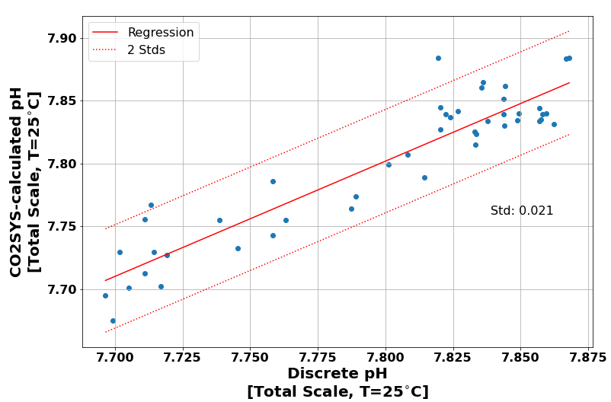
Using CO2SYS to fill in missing parameters
Recommend using the CO2SYS program which is implemented in both MatLAB & Python
Allows calculation of missing parameters from two of the four carbon system parameters
Also valuable for adjusting between lab measurements and in-situ conditions, which is needed for direct bottle and instrument comparisons
Comparison of the pH calculated from the DIC and TA using the CO2SYS program against the bottle pH [Total Scale at 25C]. Results agree to within +/- 0.021 pH-units.

Slide 9
Matching Samples
Goal is to match discrete samples to instrument samples
Several approaches
Target Asset Matching (very valuable for Cabled Array)
Latitude/Longitude Matching
Time Matching
Depth Matching
Cruise | Station | Target Asset | Niskin/Bottle Position | Niskin Flag | CTD Bottle Closure Time [UTC] | CTD Pressure [db] | CTD Pressure Flag | CTD Depth [m] | CTD Latitude [deg] | CTD Longitude [deg]
AR35-05 | 9 | GI01SUMO, GI02HYPM | 7 | *0000000000000001 | 2019-08-11T17:41:00.000Z | 2498 | *0000000000001000 | 2498 | 59.9659 | -39.56585
AR35-05 | 9 | GI01SUMO, GI02HYPM | 8 | *0000000000000001 | 2019-08-11T17:41:00.000Z | 2498 | *0000000000001000 | 2498 | 59.9659 | -39.56585
AR35-05 | 9 | GI01SUMO, GI02HYPM | 11 | *0000000000000001 | 2019-08-11T18:20:00.000Z | 503 | *0000000000001000 | 503 | 59.9659 | -39.56585
AR35-05 | 9 | GI01SUMO, GI02HYPM | 12 | *0000000000000001 | 2019-08-11T18:20:00.000Z | 503 | *0000000000001000 | 503 | 59.9659 | -39.56585
AR35-05 | 9 | GI01SUMO, GI02HYPM | 19 | *0000000000000001 | 2019-08-11T18:31:00.000Z | 81 | *0000000000001000 | 81 | 59.9659 | -39.56585
For the following figures I used an algorithm matches bottles with instrument data using thresholds of:
5 km horizontal
15 m vertical
7 days temporal

Slide 10
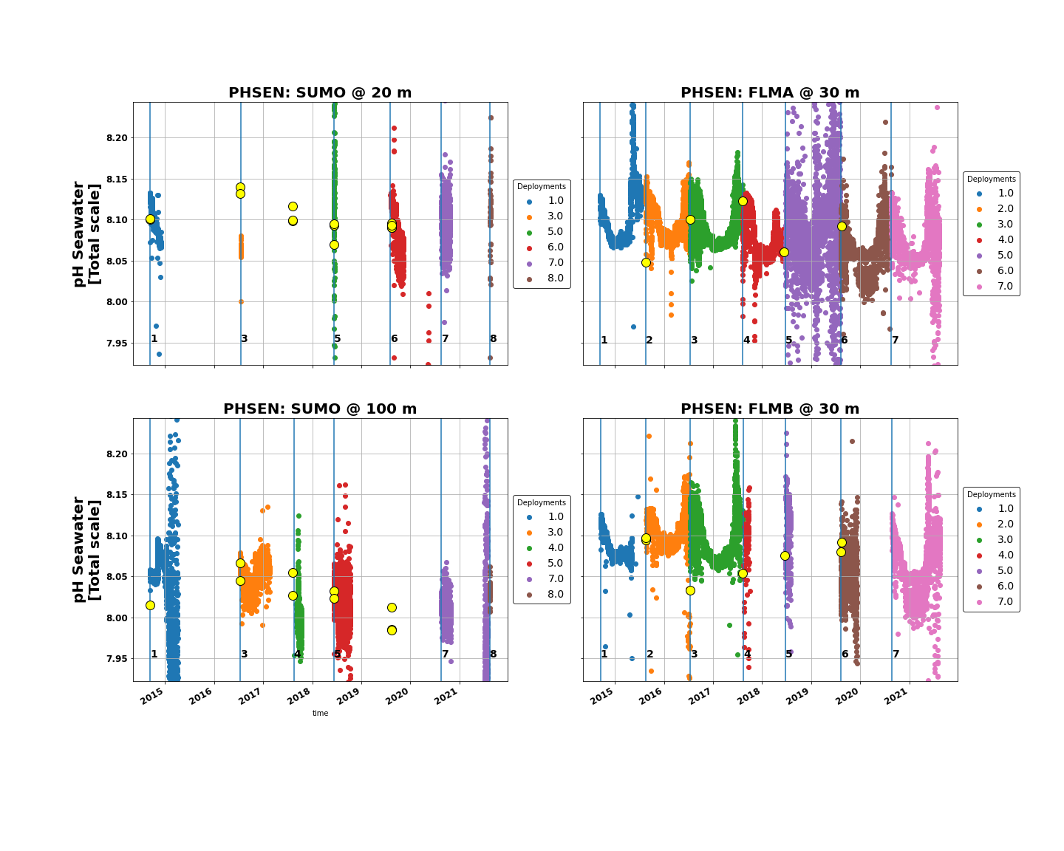
Matching Samples: Irminger Water Column pH
Time series of the Irminger Array’s Sunburst SAMI-pH seawater pH, color coded by deployment, with nearest discrete carbon samples overlaid. The instruments on the Flanking Moorings are protected by the buoy and thus have more consistent data returns than the instruments on the Apex Surface Mooring wire.

Slide 11
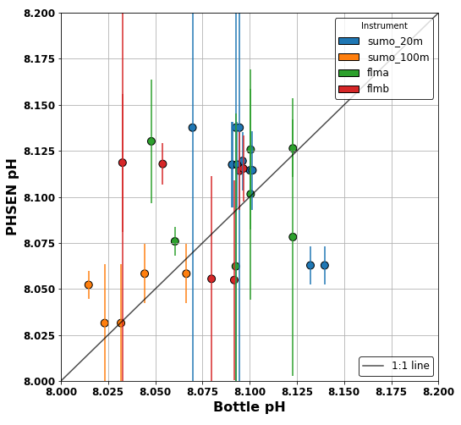
Matching Samples: Irminger Water Column pH
Time series of the Irminger Array’s Sunburst SAMI-pH seawater pH, color coded by deployment, with nearest discrete carbon samples overlaid. The instruments on the Flanking Moorings are protected by the buoy and thus have more consistent data returns than the instruments on the Apex Surface Mooring wire.
Comparison of the PHSEN measured pH with matched bottle pH, with 1:1 line drawn for comparison. Vertical lines are two standard deviations.

Slide 12
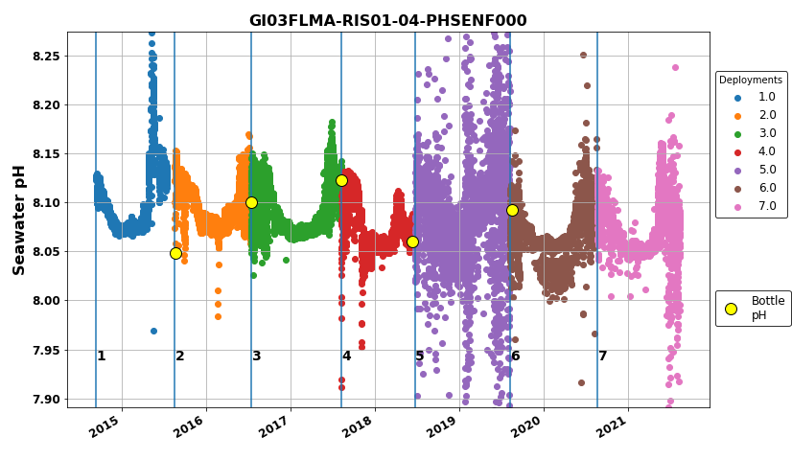
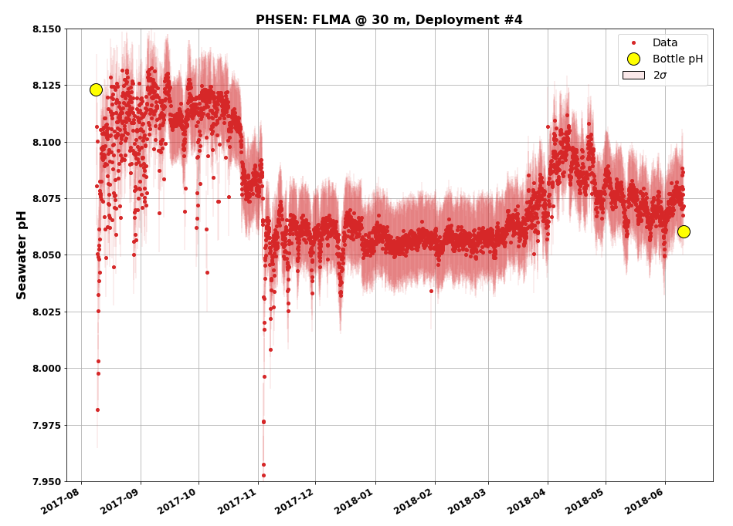
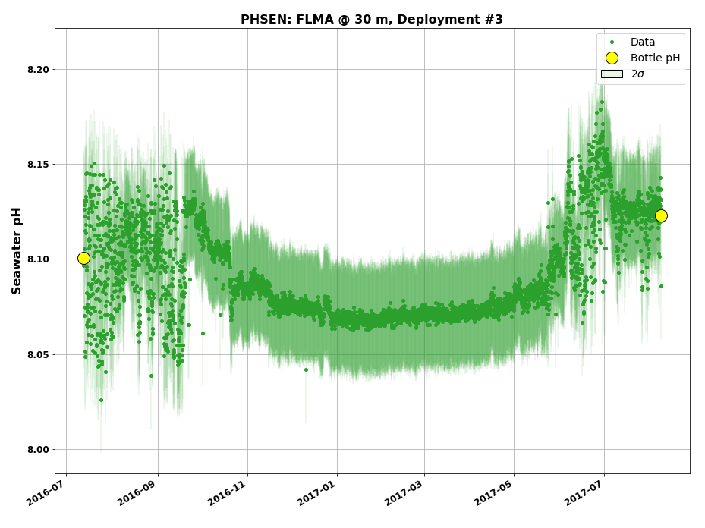
Matching Samples: Irminger Water Column pH

